Slide 1

Road Network Extraction from Satellite Imagery
Diep – nguyen9657@saskpolytech.ca
Harnil - patel7344@saskpolytech.ca
Do – thin0013@saskpolytech.ca

Slide 2
Objectives
Develop a deep learning model for high-accuracy road extraction from satellite imagery.
01
Efficiency
Automate road mapping to reduce processing time by at least 50% compared to manual methods.
02
Accuracy
Achieve >90% precision in road detection, minimizing false positives/negatives.
03
Scalability
Develop an open-source model adaptable for various terrains and satellite data sources.
04
Real-World App
Support disaster management, infrastructure planning & navigation with real-time updates.
05
Reliability
Ensure consistent and up-to-date road maps for crisis-affected regions.

Slide 3
Project Timeline
Model Optimization/Improvement
Analyze baseline performance to optimize & improve model
Implement, train and evaluate the optimized/improved model
Compare results among the baseline & optimized/improved model
Validation, Testing
Perform cross-validation to ensure model robustness
Test the model on the test set & compute final metrics
Visualize predictions, analyze failure cases & identify potential improvements
Project Planning and Data Collection
Research and finalize topic with suitable datasets
Define project goals, scope, & success metrics
Prepare high level proposal & presentation
Set up the development environment
Feb 2025
Apr 2025
Jan 2025
Mar 2025
Data Preprocessing and Exploration
Load and explore the dataset (Visualize satellite images & road mask)
Preprocess the data (Resize, normalize, split data)
Augment the dataset (Rotation, flipping, cropping)
Model Selection and Baseline Development
Select model and implement a baseline model
Train and evaluate the baseline model
Deployment
Convert the trained model to a deployable format
Develop a simple pipeline for inference & test
Finalization and Documentation
Prepare a detailed project report & presentation
Conclude the project with programming codes & reports

Slide 4
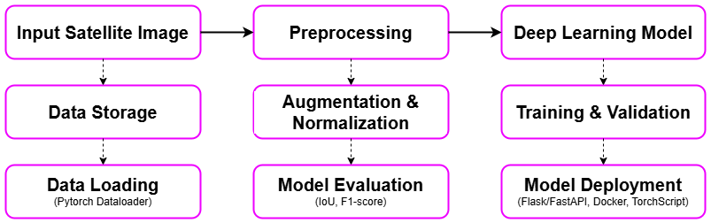
Project Block Diagram

Slide 5
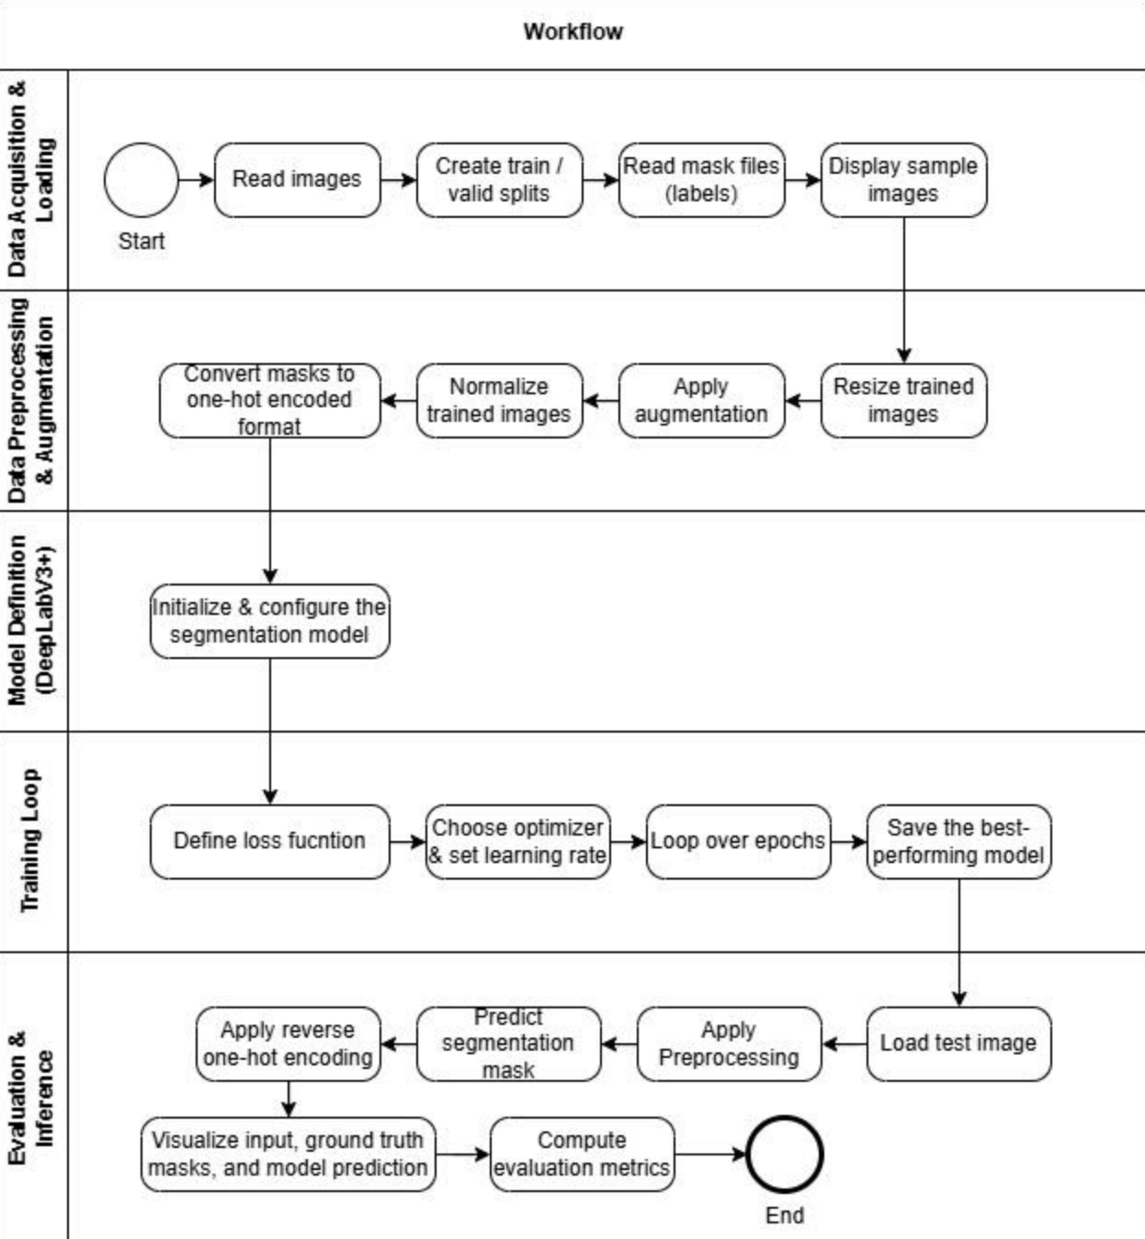
Project Flowchart

Slide 6
Dataset
Kaggle, containing high-resolution satellite images with road network annotations (https://www.kaggle.com/datasets/balraj98/deepglobe-road-extraction-dataset/data).

Slide 7
Detail Data Preprocessing

Slide 8
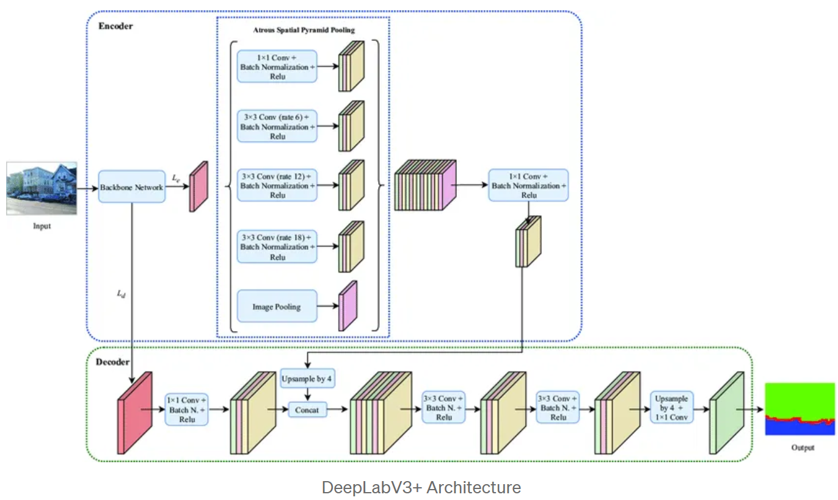
Modelling
Framework: PyTorch.
Libraries: Torchvision, OpenCV, NumPy, Pandas, Matplotlib, Scikit-learn.
Model: DeepLabV3+
Training and Evaluation: Trained using a labeled dataset and evaluated using metrics (Intersection over Union, F1-Score).
Deployment: Flask/FastAPI, Docker, TorchScript.

Slide 9
Results and Analysis
(should cover comparison analysis with benchmark)

Slide 10
Project progress self-assessment
(have Gantt chart with project completion percentage)

Slide 11
Future work
Find the shortest way between two points on extracted street network (using Dijkstra’s
algorithm)

Slide 12
References (1/2)
Liu, Y., Guo, Y., Zhang, F., & Wang, X. (2024). A Novel Network Framework on Simultaneous Road Segmentation and Vehicle Detection for UAV Aerial Traffic Images.Sensors, 24(11), 3606.
Mnih, V., & Hinton, G. (2018). "Learning to Detect Roads in High-Resolution Aerial Images." Neural Information Processing Systems (NeurIPS).
Sun, H., Wu, Y., & Zhang, J. (2021). "Improved Satellite Road Extraction Using DeepLabV3+ with Attention Mechanisms." IEEE Geoscience and Remote Sensing Letters.

Slide 13
References (2/2)
Bahrampour, S., Ramakrishnan, N., Schott, L., & Shah, M. (2015). Comparative Study of Deep Learning Software Frameworks. arXiv preprint arXiv:1511.06435.
Dubovikov, K. (2018). PyTorch vs TensorFlow — Spotting the Difference. Towards Data Science.
Al-Bdour, G., Al-Qurran, R., Al-Ayyoub, M., & Shatnawi, A. (2019). A Detailed Comparative Study of Open Source Deep Learning Frameworks. arXiv preprint arXiv:1903.00102.

